Slide 1

Bayesian based intrusion detection system
Basava R Kanaparthi

Slide 2
What’s IDS?
“An intrusion detection system (IDS) is a device or software application that monitors network or system activities for malicious activities or policy violations and produces electronic reports to a management station” – Wikipedia
Use one of these two techniques:
Signature-based IDS
But effectiveness is determined by the false alarms, usually high
Statistical anomaly-based IDS
Bayesian approach, tries to improve this aspect.
* Email spam-filters, Speech recognition, Pattern Recognition also use this Bayesian approach.

Slide 3
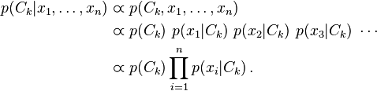

Background
Bayesian Theory
If the events x₁, x₂, … and x_{n} constitute a partition of the sample space S such that p(x_{k}) ≠ 0 for k = 1,2 , … , n, then for any event B such that P(B) ≠ 0:
p$\left(x_{i} | C\right)=\frac{p\left(x_{i}∩C\right)}{P\left(C\right)}=\frac{p\left(x\right)P\left(C \right|x_{i})}{\sum_{k=1}^{n}{p\left(x_{i}\right)P\left(C | x_{k}\right)}}=\frac{p\left(x_{i}\right)p\left(C | x_{i}\right)}{p\left(C\right)}$
Uses Naïve Bayes approximation, i.e., each of the feature component is independent of the others

Slide 4
Characteristics
Dataset features (KDD-99 dataset)
Total 41 features for each TCP connection, which are divided into 4 categories:
Basis features: Features 1-9 are the basic features that are derived from packet header.
Content features: Domain knowledge is used to assess the payload of the original TCP packets. This includes features such as the number of failed login attempts.
Time-based traffic features: These are features that capture properties that mature over a 2-s temporal window. An example is the number of connections to the same host over the 2-s interval.
Host-based traffic features: These features utilize a historical window estimated over the number of connection instead of time. They are designed to assess attacks, which span intervals longer than 2s.

Slide 5

Training phase – Supervised learning
Using the 10% KDD data set we have 494,020 records that are used to train the training engine.

Slide 6
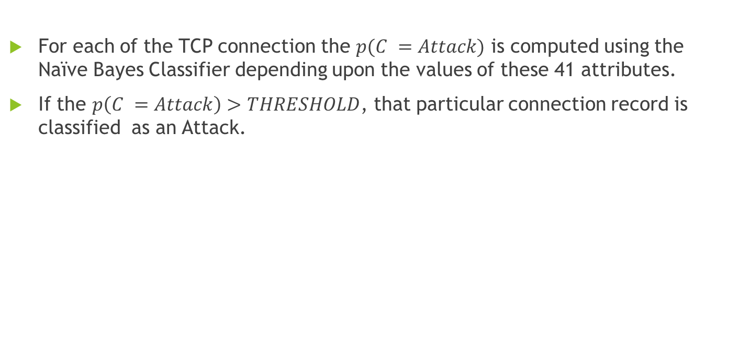
Testing phase
For each of the TCP connection the $p(C =Attack)$ is computed using the Naïve Bayes Classifier depending upon the values of these 41 attributes.
If the $p\left(C =Attack\right)>THRESHOLD$, that particular connection record is classified as an Attack.
Table 1.
Experiment testing environment.
Testing data | No of records | Features | Threshold
Normal | 60,593 | All | 0.9
All attacks | 250,436 | All | 0.9
DOS | 165,299 | All | 0.9
Probing | 4166 | All | 0.9
U2R | 188 | 23,24,31 | 0.6
R2L | 16,180 | 23,24,31 | 0.6

Slide 7
Results
Table 2.
Test results percentages.
Test | TN | TP | FN | FP
All attacks | 99.03 | 89.7 | 0.97 | 10.3
DOS | 99.03 | 99.36 | 0.97 | 0.64
Probing | 99.03 | 57.15 | 0.97 | 42.85
U2R | 99.40 | 91.50 | 0.60 | 8.50
R2L | 99.40 | 61.50 | 0.60 | 38.50

